Slide 1
Group 5: Cuba
Matt Bell // Christina Amezquita // Terry Tan // // Michelle Lupisan // November 11, 2013

Slide 2
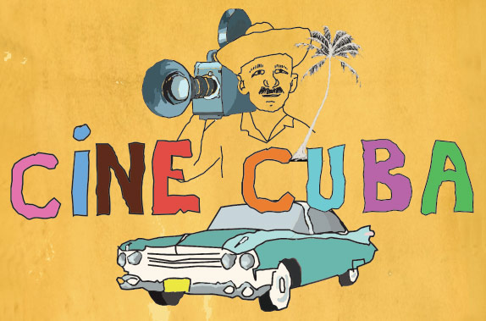
Cinema in Cuba
Arrived in Cuba in beginning of 20th century
Most films were melodramas
80 full-length films produced before Cuban Revolution
After revolution: “Golden Age” of Cuban cinema

Slide 3
Cuban Revolution
Fidel Castro against the Cuban president Batista
Ousted Batista on Jan 1, 1959
Replaced his gov’t with a socialist state
Later became the Communist party.
Nationalization and political consolidation

Slide 4
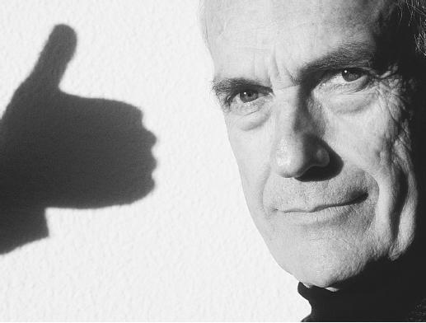
Tomas Gutierrez Alea
Born in Havana, 1928
Received law degree from University of Havana. Studied cinema in Rome
Wrote and directed more than 20 features
Known for his sharp insight into post-Revolutionary Cuba
Criticism of social, economic, political conditions

Slide 5
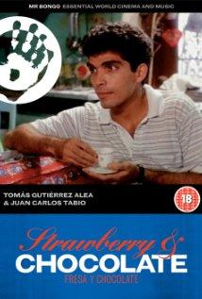
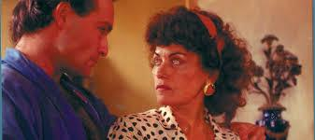
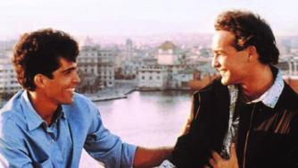
Strawberry and Chocolate
-Based on “The Wolf, The Forest,
and the New Man
-Havana, Cuba 1979
-Published in 1990
-Film’s Portrayal
-Spiritual Aspect
-LGBT Community

Slide 6
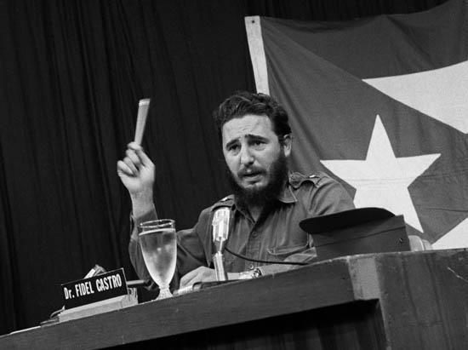
Homosexuality: Fidel Castro
Castro’s Interview set the tone for the Cuban nation
Castro explained 1965 interview:
-“We would never come to believe that a homosexual could embody the conditions and requirements of conduct that would enable us to consider him a true Revolutionary, a true Communist militant. A deviation of that nature clashes with the concept we have of what a militant Communist must be.”

Slide 7
Homosexuality in Cuba
Castro considered it a devious product of capitalism
During 60’s and 70’s: homosexual men were imprisoned, lost their jobs
Incarcerated in UMAP (Military Units to Aid Production)

Slide 8
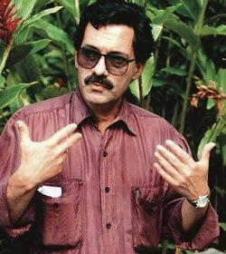
Juan Carlos Tabio
-Born 1942 Havana, Cuba
-Accidental filmmaker
-Began 1961, first film 1983
-Received Awards

Slide 9
Guantanamera
-Released 1994/95
-Romantic Comedy
-Takes place during “Special
Period” (1990)
-What was the “Special Period?”

Slide 10
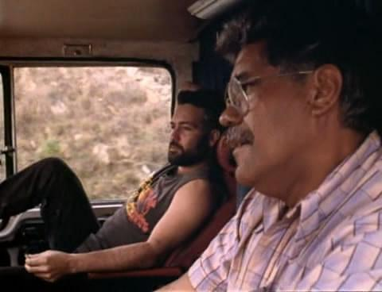
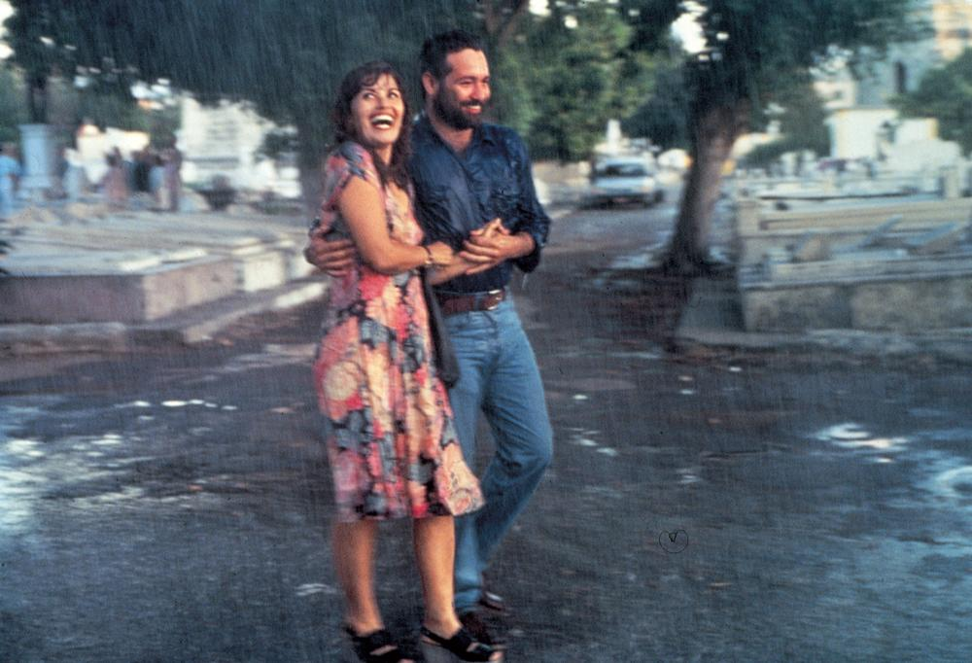
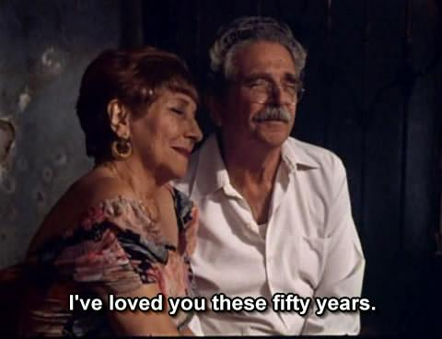
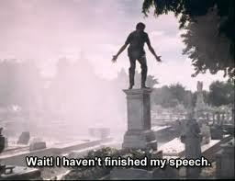
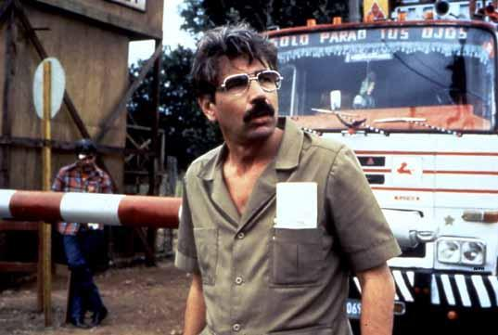
Guantanamera
-Started by Tomas, finished
by Juan Carlos
-Mariano
Engineer → Truck Driver
-Adolfo: Goverment Worker
-Gina: Cuban women of
1970-1990

Slide 11
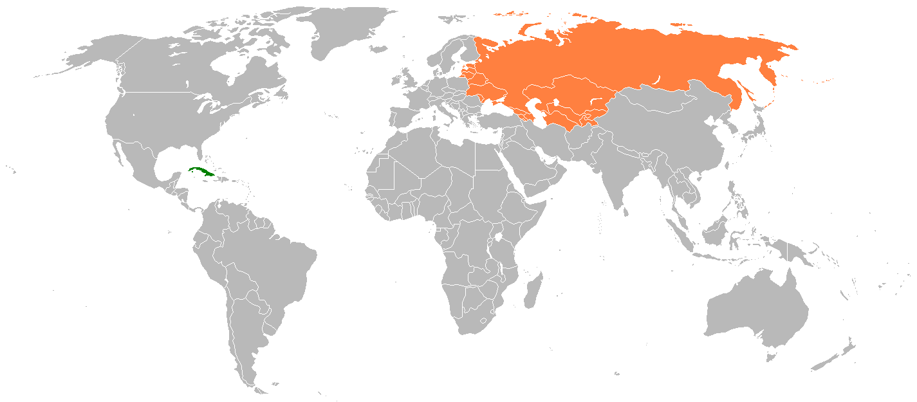
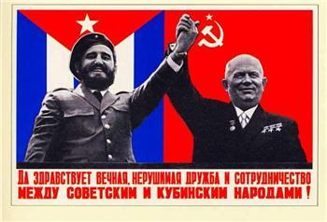
Cuban-Soviet Relations
-Started during WWII
-Little interest in Castro
-USA’s embargo led to sugar-fuel trade
-Bay of Pigs 1961: Socialistic → Russian Support
-Sugar and Petroleum
-By 1990, hard to keep trade

Slide 12
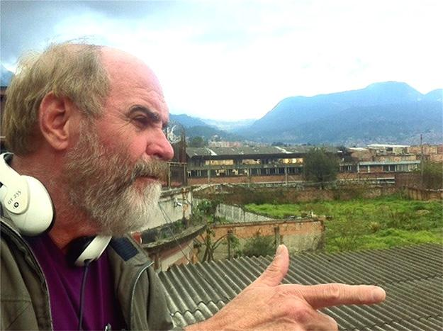
Leon Ichaso
Born Havana, 1948
Family of well known artists, journalists, writers
Left Cuba for Mexico and the US at age 14
Specializes in gritty urban realism
First film: “El Super”

Slide 13
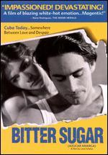
Bitter Sugar
1996 film,nominated “Best Foreign Language Film”
Hollywood style romance
Tourism, Currency, Prostitution
Disillusionment in the Revolution
AIDS injection- political protest

Slide 14
AIDS Self-Injection
A political protest
Cubans had little freedom of expression
Quarantined to sanitariums
Sanitariums had better conditions

Slide 15
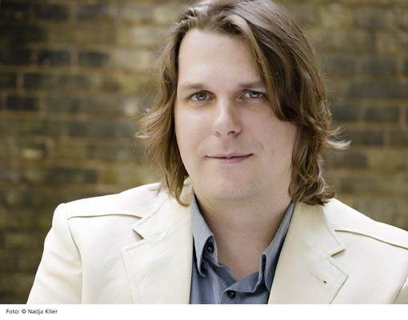
Florian Borchmeyer
born 1974 in
wasserburg
Studied at the
Universite de la
Sorbonne Nouvelle
co-directed and
wrote Havana: The
New art of making
ruins in 1997

Slide 16
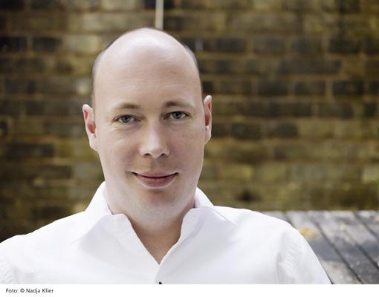
Matthias Hentshier
born 1973 in Berlin
work as a journalist
co-directed and wrote
Havana: The New art of
making ruins in 1997

Slide 17
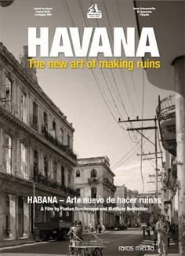
Havana: The New Art of Making Ruins
released in 2005
Havana Cuba
remnants of Havana
I’m not telling you what
happens so you can watch it
yourself.

Slide 18
bibliography
http://en.wikipedia.org/wiki/Tom%C3%A1s_Guti%C3%A9rrez_Alea
http://en.wikipedia.org/wiki/LGBT_rights_in_Cuba
http://en.wikipedia.org/wiki/Special_Period
http://www.filmscouts.com/scripts/review.cfm?File=guantan
http://mubi.com/films/guantanamera
http://en.wikipedia.org/wiki/Cuba%E2%80%93Soviet_Union_relations
http://www.angelfire.com/pr/red/cuba/status_of_cuban_women.htm
http://en.wikipedia.org/wiki/Cuba%E2%80%93Soviet_Union_relations
http://www.cubahistory.org/en/special-period-a-recovery.html
http://www.nytimes.com/movie/review?res=9405E7DC163DF931A15752C1A960958260
http://en.wikipedia.org/wiki/Cinema_of_Cuba
http://community.seattletimes.nwsource.com/archive/?date=19950117&slug=2099882

